Slide 1
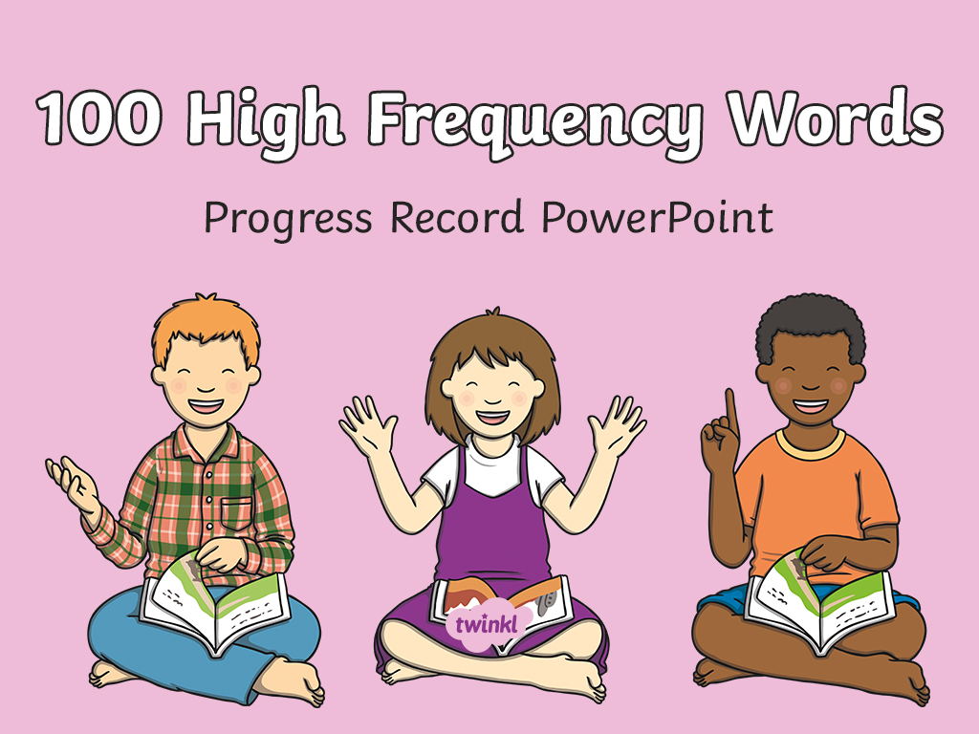

Slide 2
the

Slide 3
and

Slide 4
a

Slide 5
to

Slide 6
said

Slide 7
in

Slide 8
he

Slide 9
I

Slide 10
of

Slide 11
it

Slide 12
was

Slide 13
you

Slide 14
they

Slide 15
on

Slide 16
she

Slide 17
is

Slide 18
for

Slide 19
at

Slide 20
his

Slide 21
but

Slide 22
that

Slide 23
with

Slide 24
all

Slide 25
we

Slide 26
can

Slide 27
are

Slide 28
up

Slide 29
had

Slide 30
my

Slide 31
her

Slide 32
what

Slide 33
there

Slide 34
out

Slide 35
this

Slide 36
have

Slide 37
went

Slide 38
be

Slide 39
like

Slide 40
some

Slide 41
not

Slide 42
then

Slide 43
were

Slide 44
go

Slide 45
little

Slide 46
as

Slide 47
no

Slide 48
mum

Slide 49
one

Slide 50
them

Slide 51
do

Slide 52
me

Slide 53
down

Slide 54
dad

Slide 55
big

Slide 56
when

Slide 57
it’s

Slide 58
see

Slide 59
looked

Slide 60
very

Slide 61
look

Slide 62
don’t

Slide 63
come

Slide 64
will

Slide 65
into

Slide 66
back

Slide 67
from

Slide 68
children

Slide 69
him

Slide 70
Mr

Slide 71
get

Slide 72
just

Slide 73
now

Slide 74
came

Slide 75
oh

Slide 76
about

Slide 77
got

Slide 78
their

Slide 79
people

Slide 80
your

Slide 81
put

Slide 82
could

Slide 83
house

Slide 84
old

Slide 85
too

Slide 86
by

Slide 87
day

Slide 88
made

Slide 89
time

Slide 90

I’m

Slide 91
if

Slide 92
help

Slide 93
Mrs

Slide 94
called

Slide 95
here

Slide 96
off

Slide 97
asked

Slide 98
saw

Slide 99
make

Slide 100
an

Slide 101
so

